Slide 1
Adverbs of frecuency
By José Francisco Ortiz Morales

Slide 2
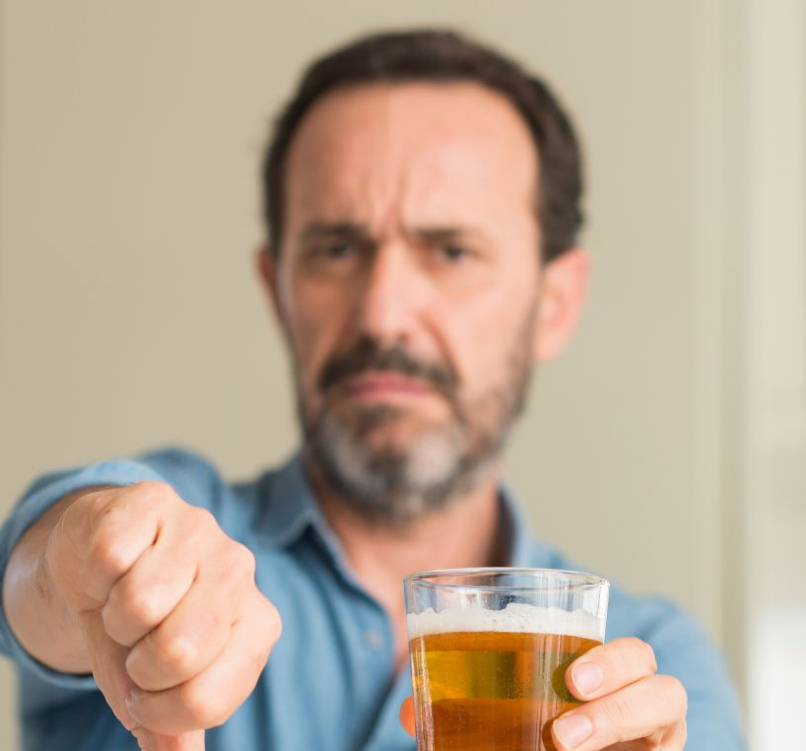
Never 0%
I never go out to drink.

Slide 3

Hardly Ever 5%
I hardly ever study after the classes finished.

Slide 4
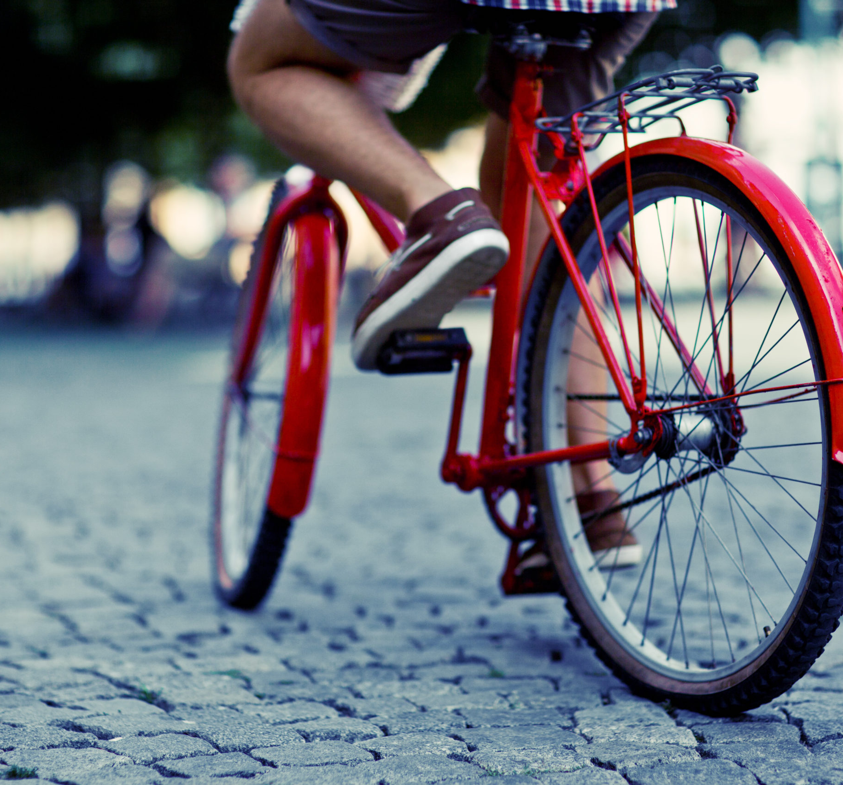
Seldom 10%
I seldom drive my bycicle.

Slide 5
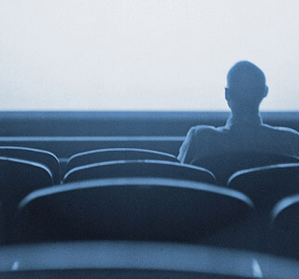
Occasionally 30%
I occasionally go to the cinema.

Slide 6
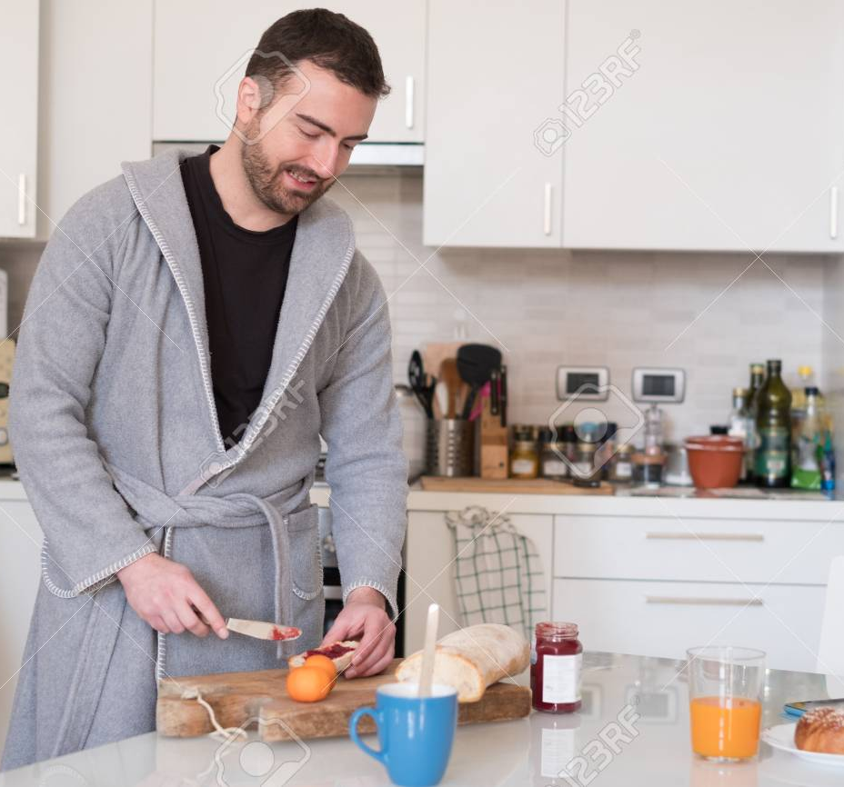
Sometimes 50%
I sometimes make my own breakfast.

Slide 7
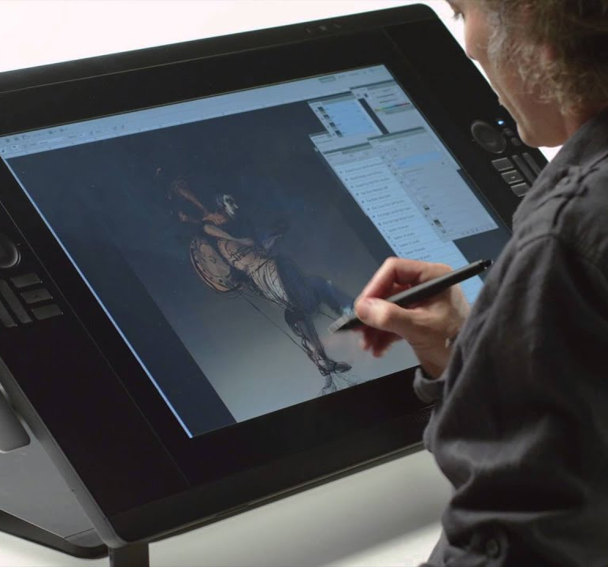
Often 70%
I often draw on the evening.

Slide 8
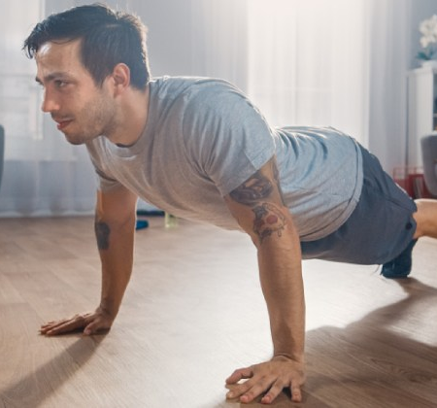
Normally 80%
I normally do exercies in my house.

Slide 9
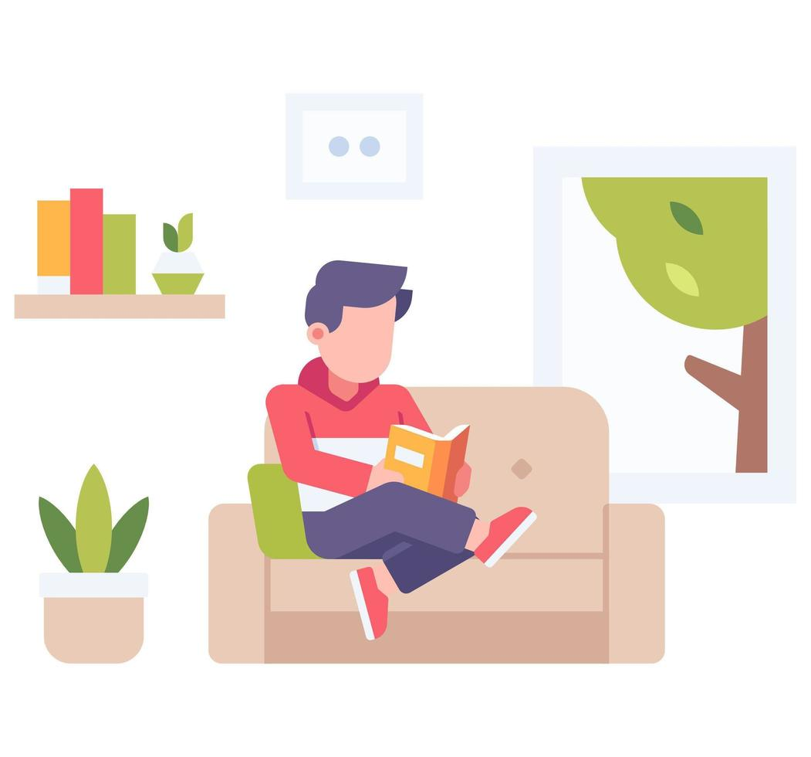
Usually 90%
I usually read a book.

Slide 10
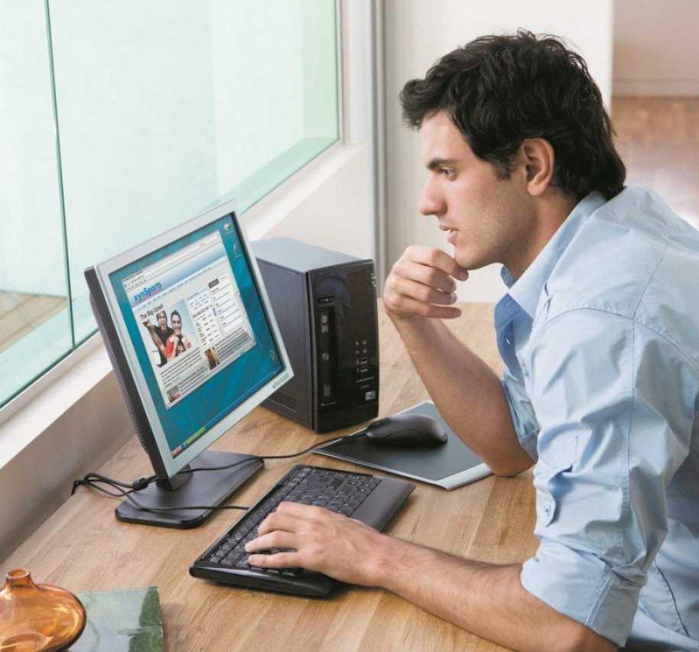
Always 100%
I always spend time on my pc.

